Slide 1
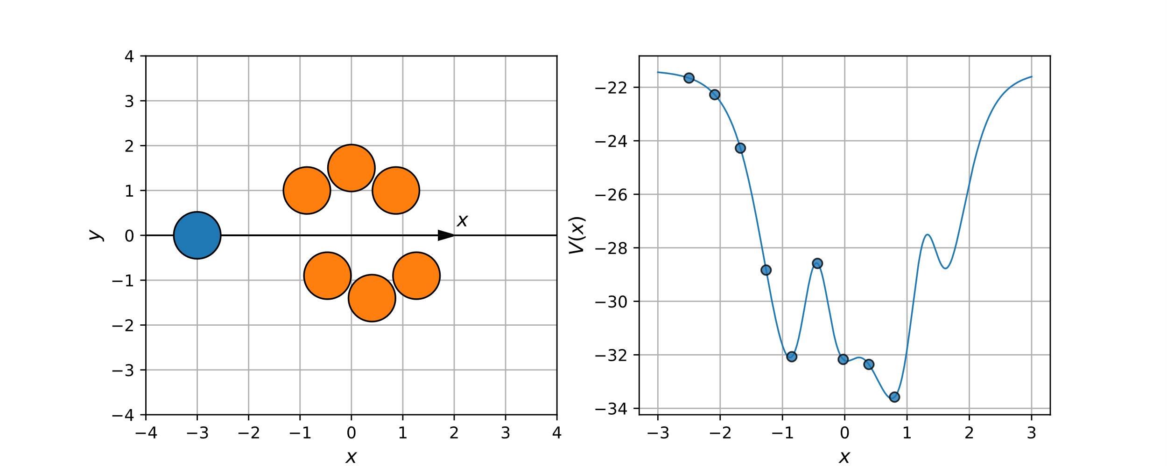
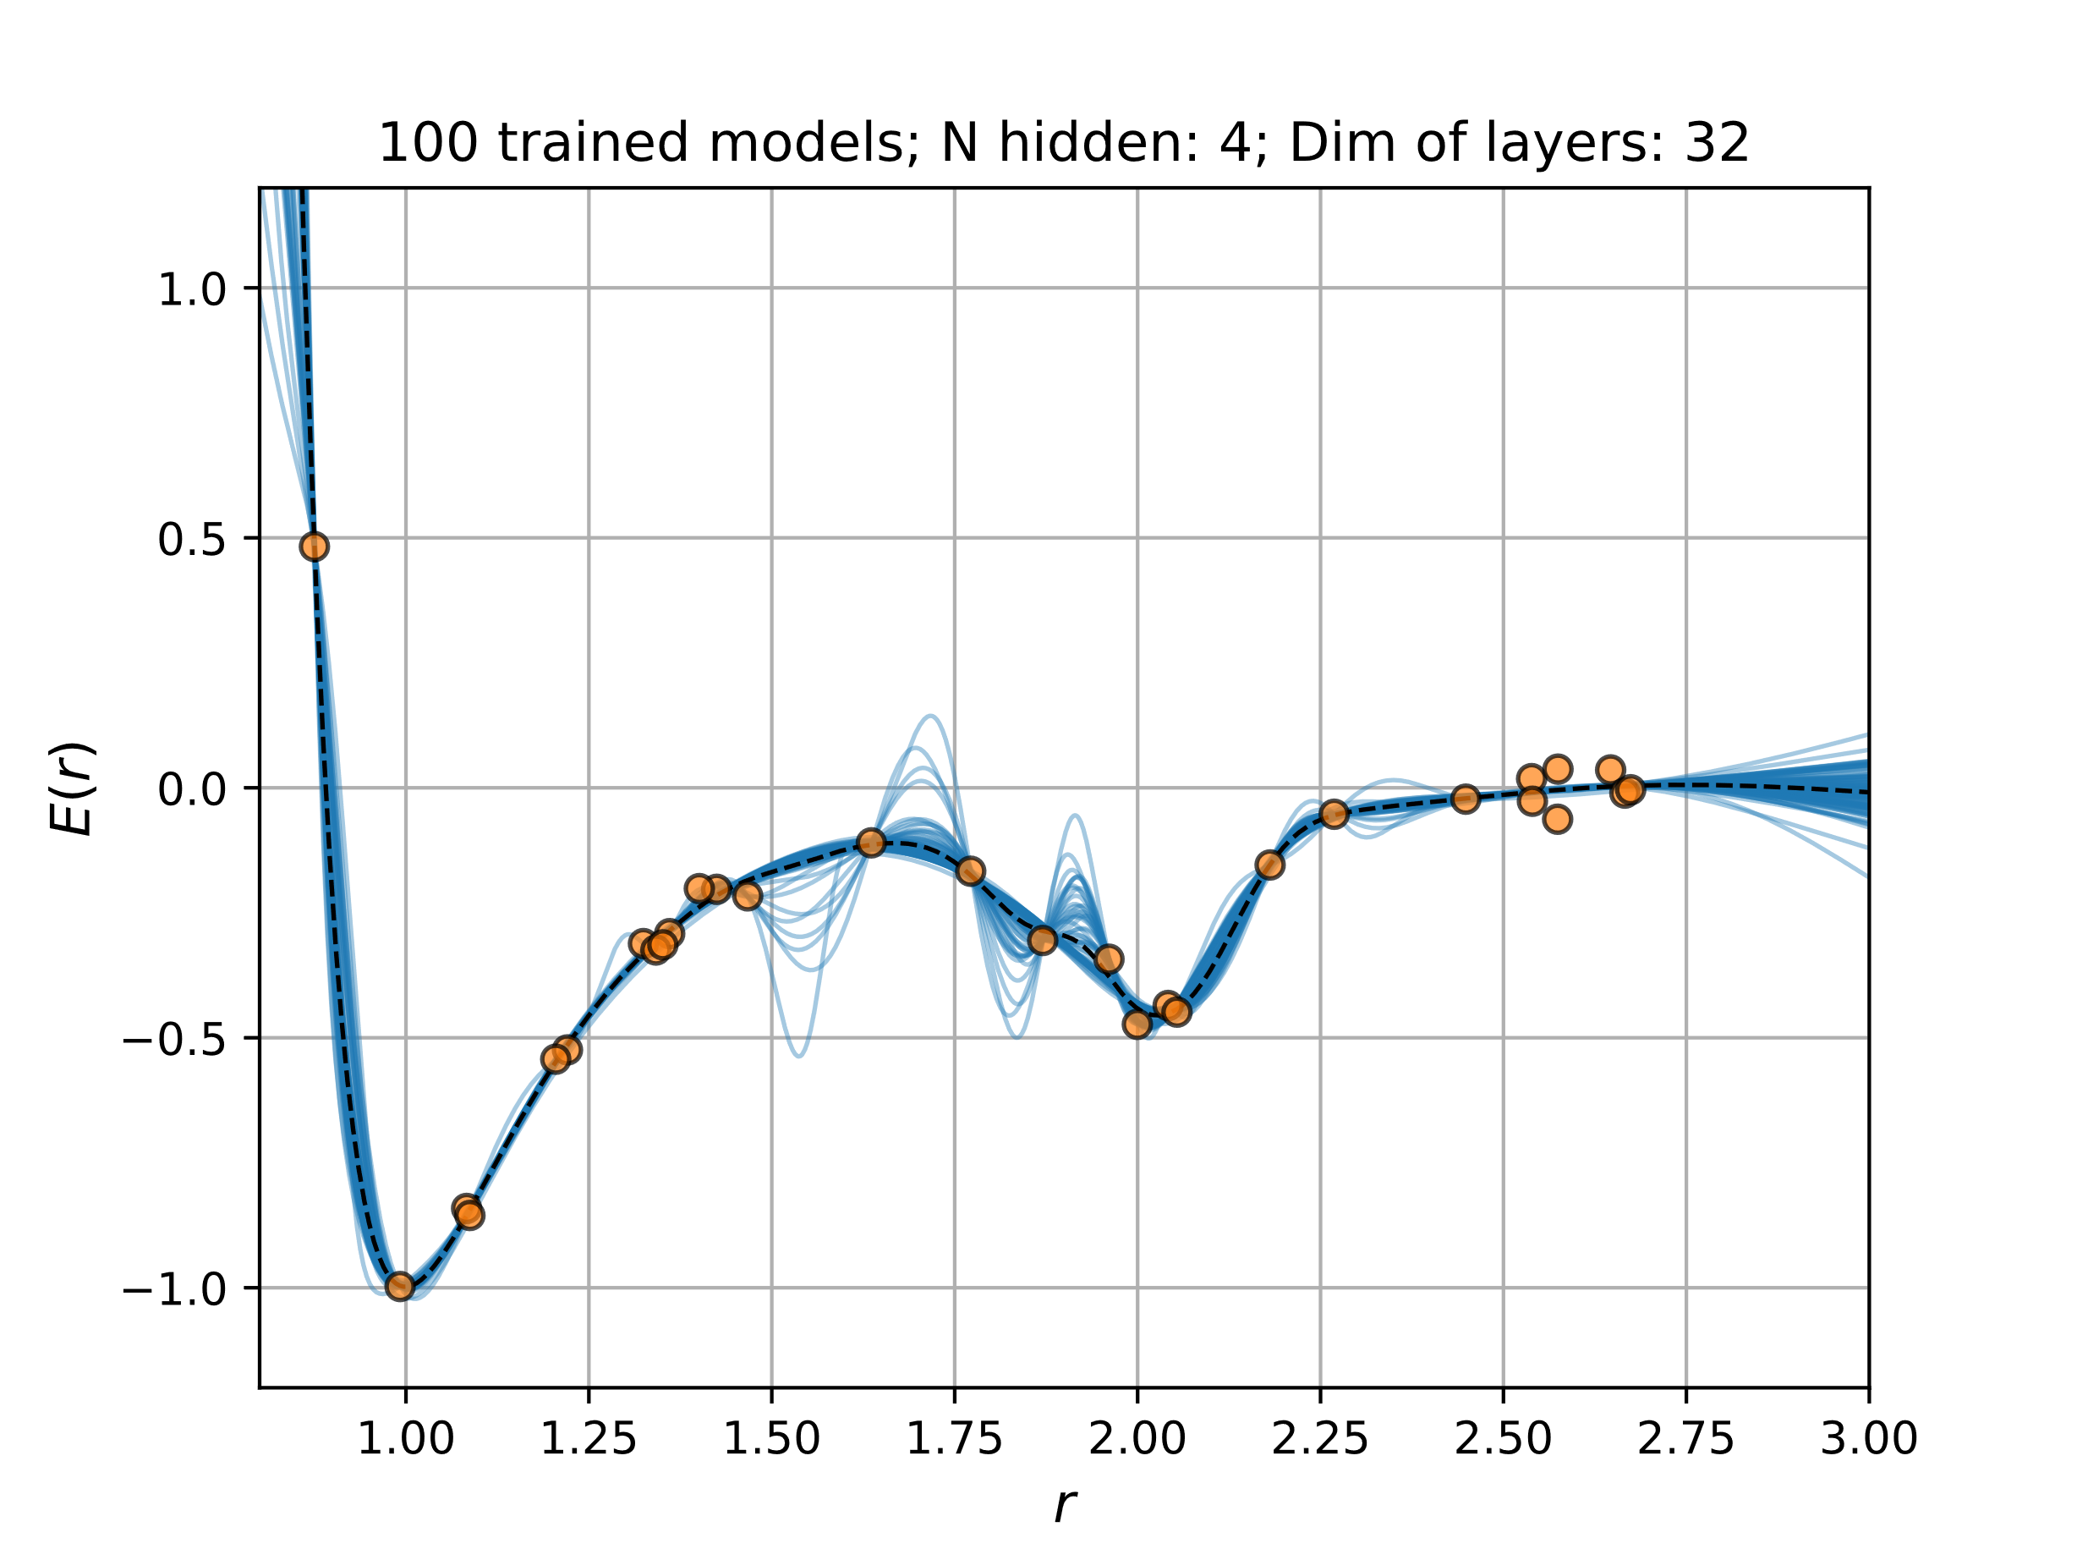
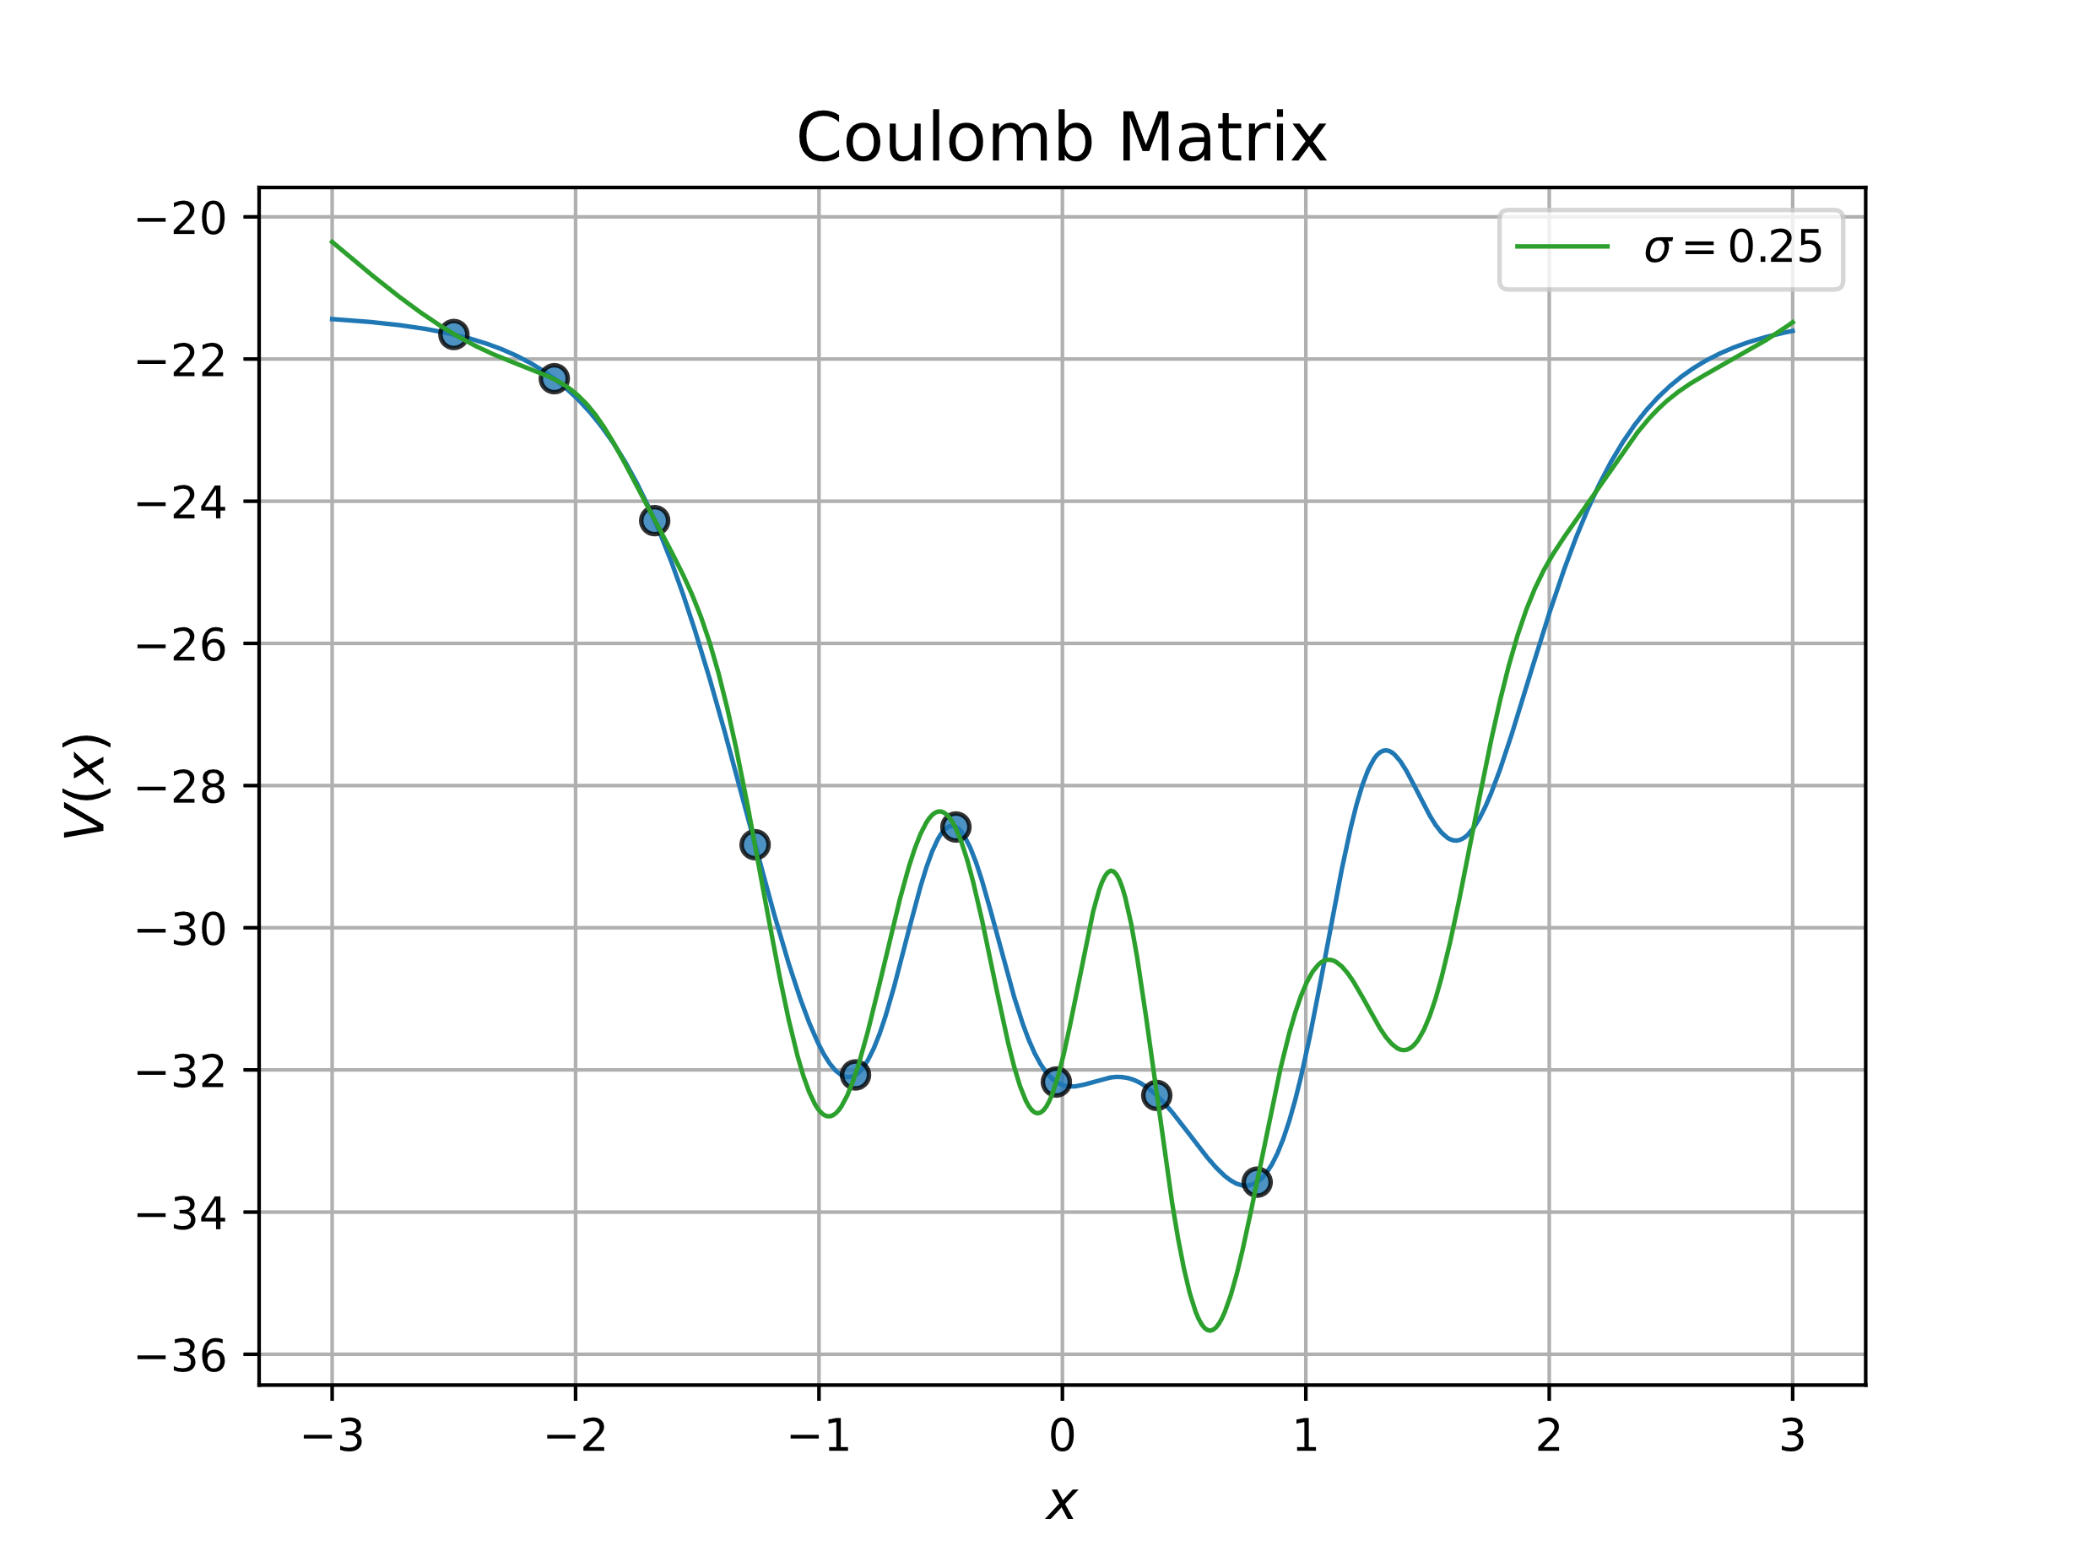
Regression

Slide 2
Outline
Goal: Understand Regression of different types
Regression: Find relationship between dependent & independent variable
Parametric regression
Ordinary Least Squares (OLS) Regression
Ridge Regression
Kernel Ridge Regression
Exercises to illustrate points
Benefits/disadvantages
Exercises: Using Neural Networks for regression

Slide 3
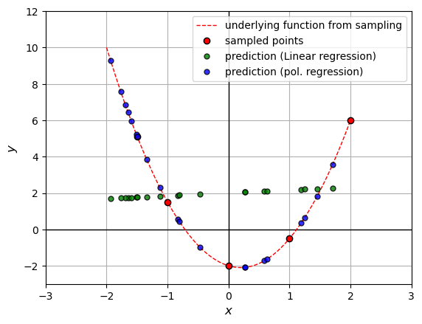
Parametric Regression – OLS regression
Derivation & idea
Benefits:
Closed form solutions
Disadvantages:
Has tendency to overfit
We have to assign form of fit

Slide 4
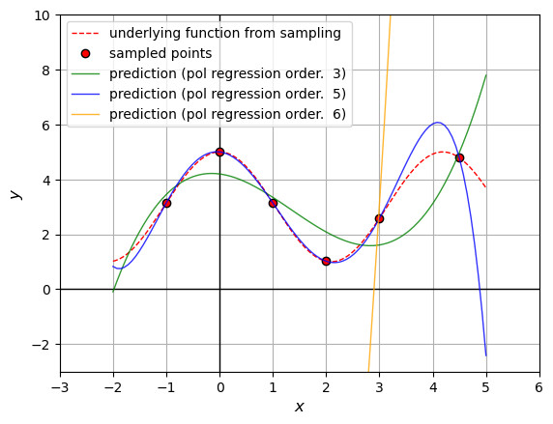
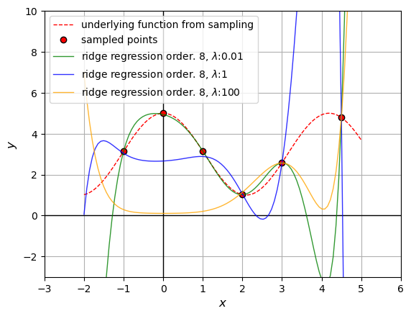
Parametric Regression – Ridge Regression
OLS overfits and unstable → Add regularization
Exercise 30
After regularization

Slide 5
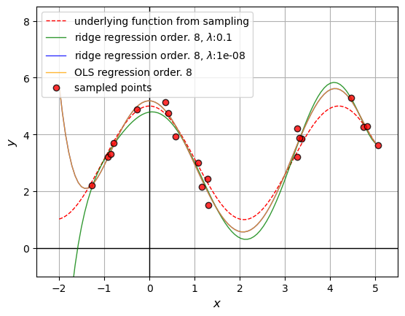
Parametric Regression – Ridge Regression

Slide 6
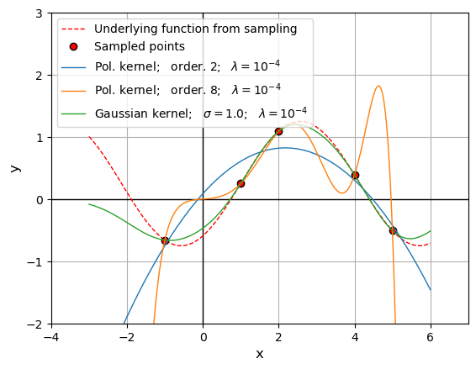
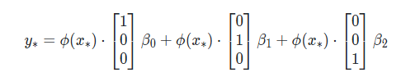
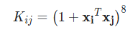
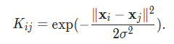
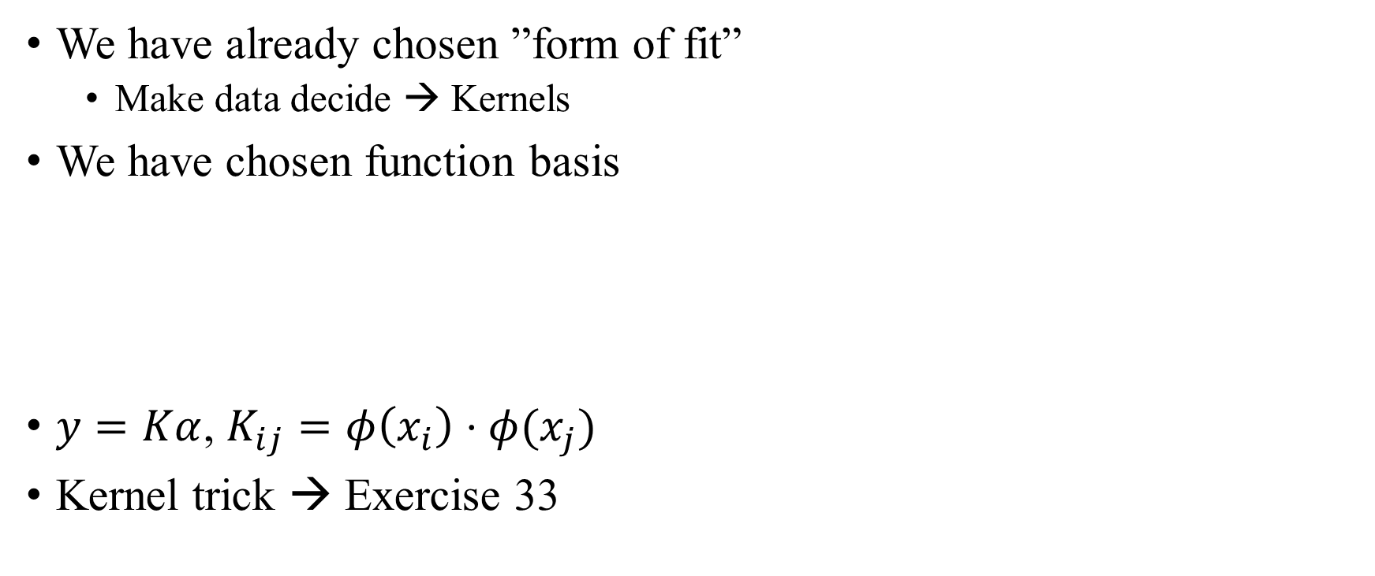
Parametric Regression – Kernel Ridge Regression
We have already chosen ”form of fit”
Make data decide → Kernels
We have chosen function basis
$y=Kα$, $K_{ij}=φ\left(x_{i}\right)⋅φ(x_{j})$
Kernel trick → Exercise 33

Slide 7
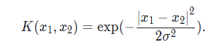
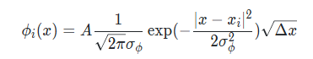
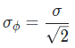
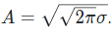
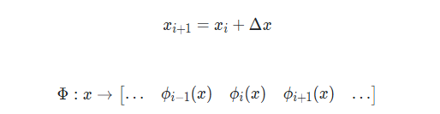
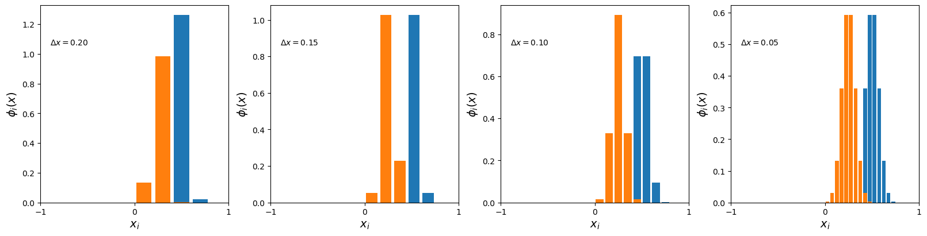
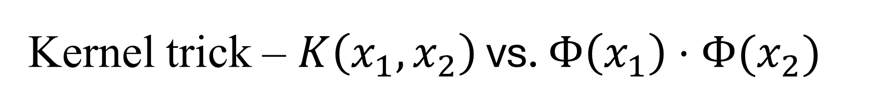
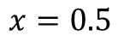
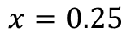
Kernel trick – $K\left(x_{1},x_{2}\right)$ vs. $Φ\left(x_{1}\right)⋅Φ(x_{2})$
$$x=0.25$$
$$x=0.5$$

Slide 8
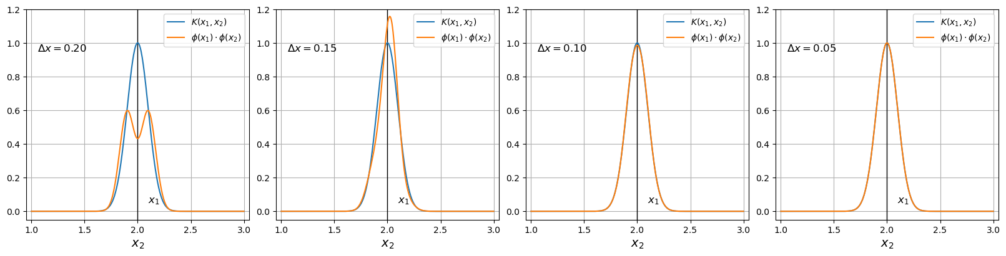
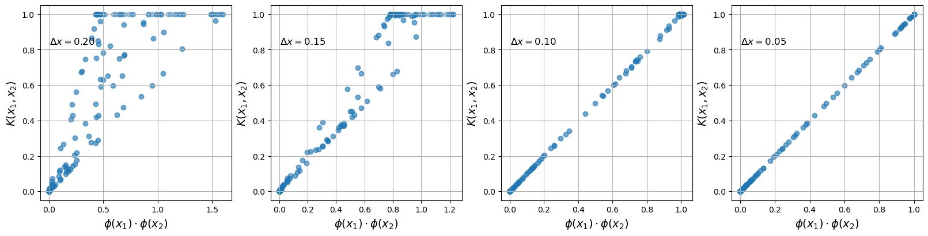
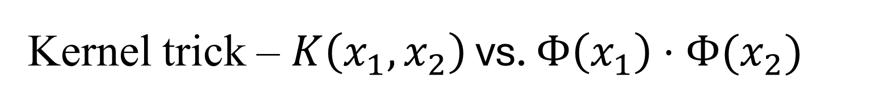
Kernel trick – $K\left(x_{1},x_{2}\right)$ vs. $Φ\left(x_{1}\right)⋅Φ(x_{2})$

Slide 9
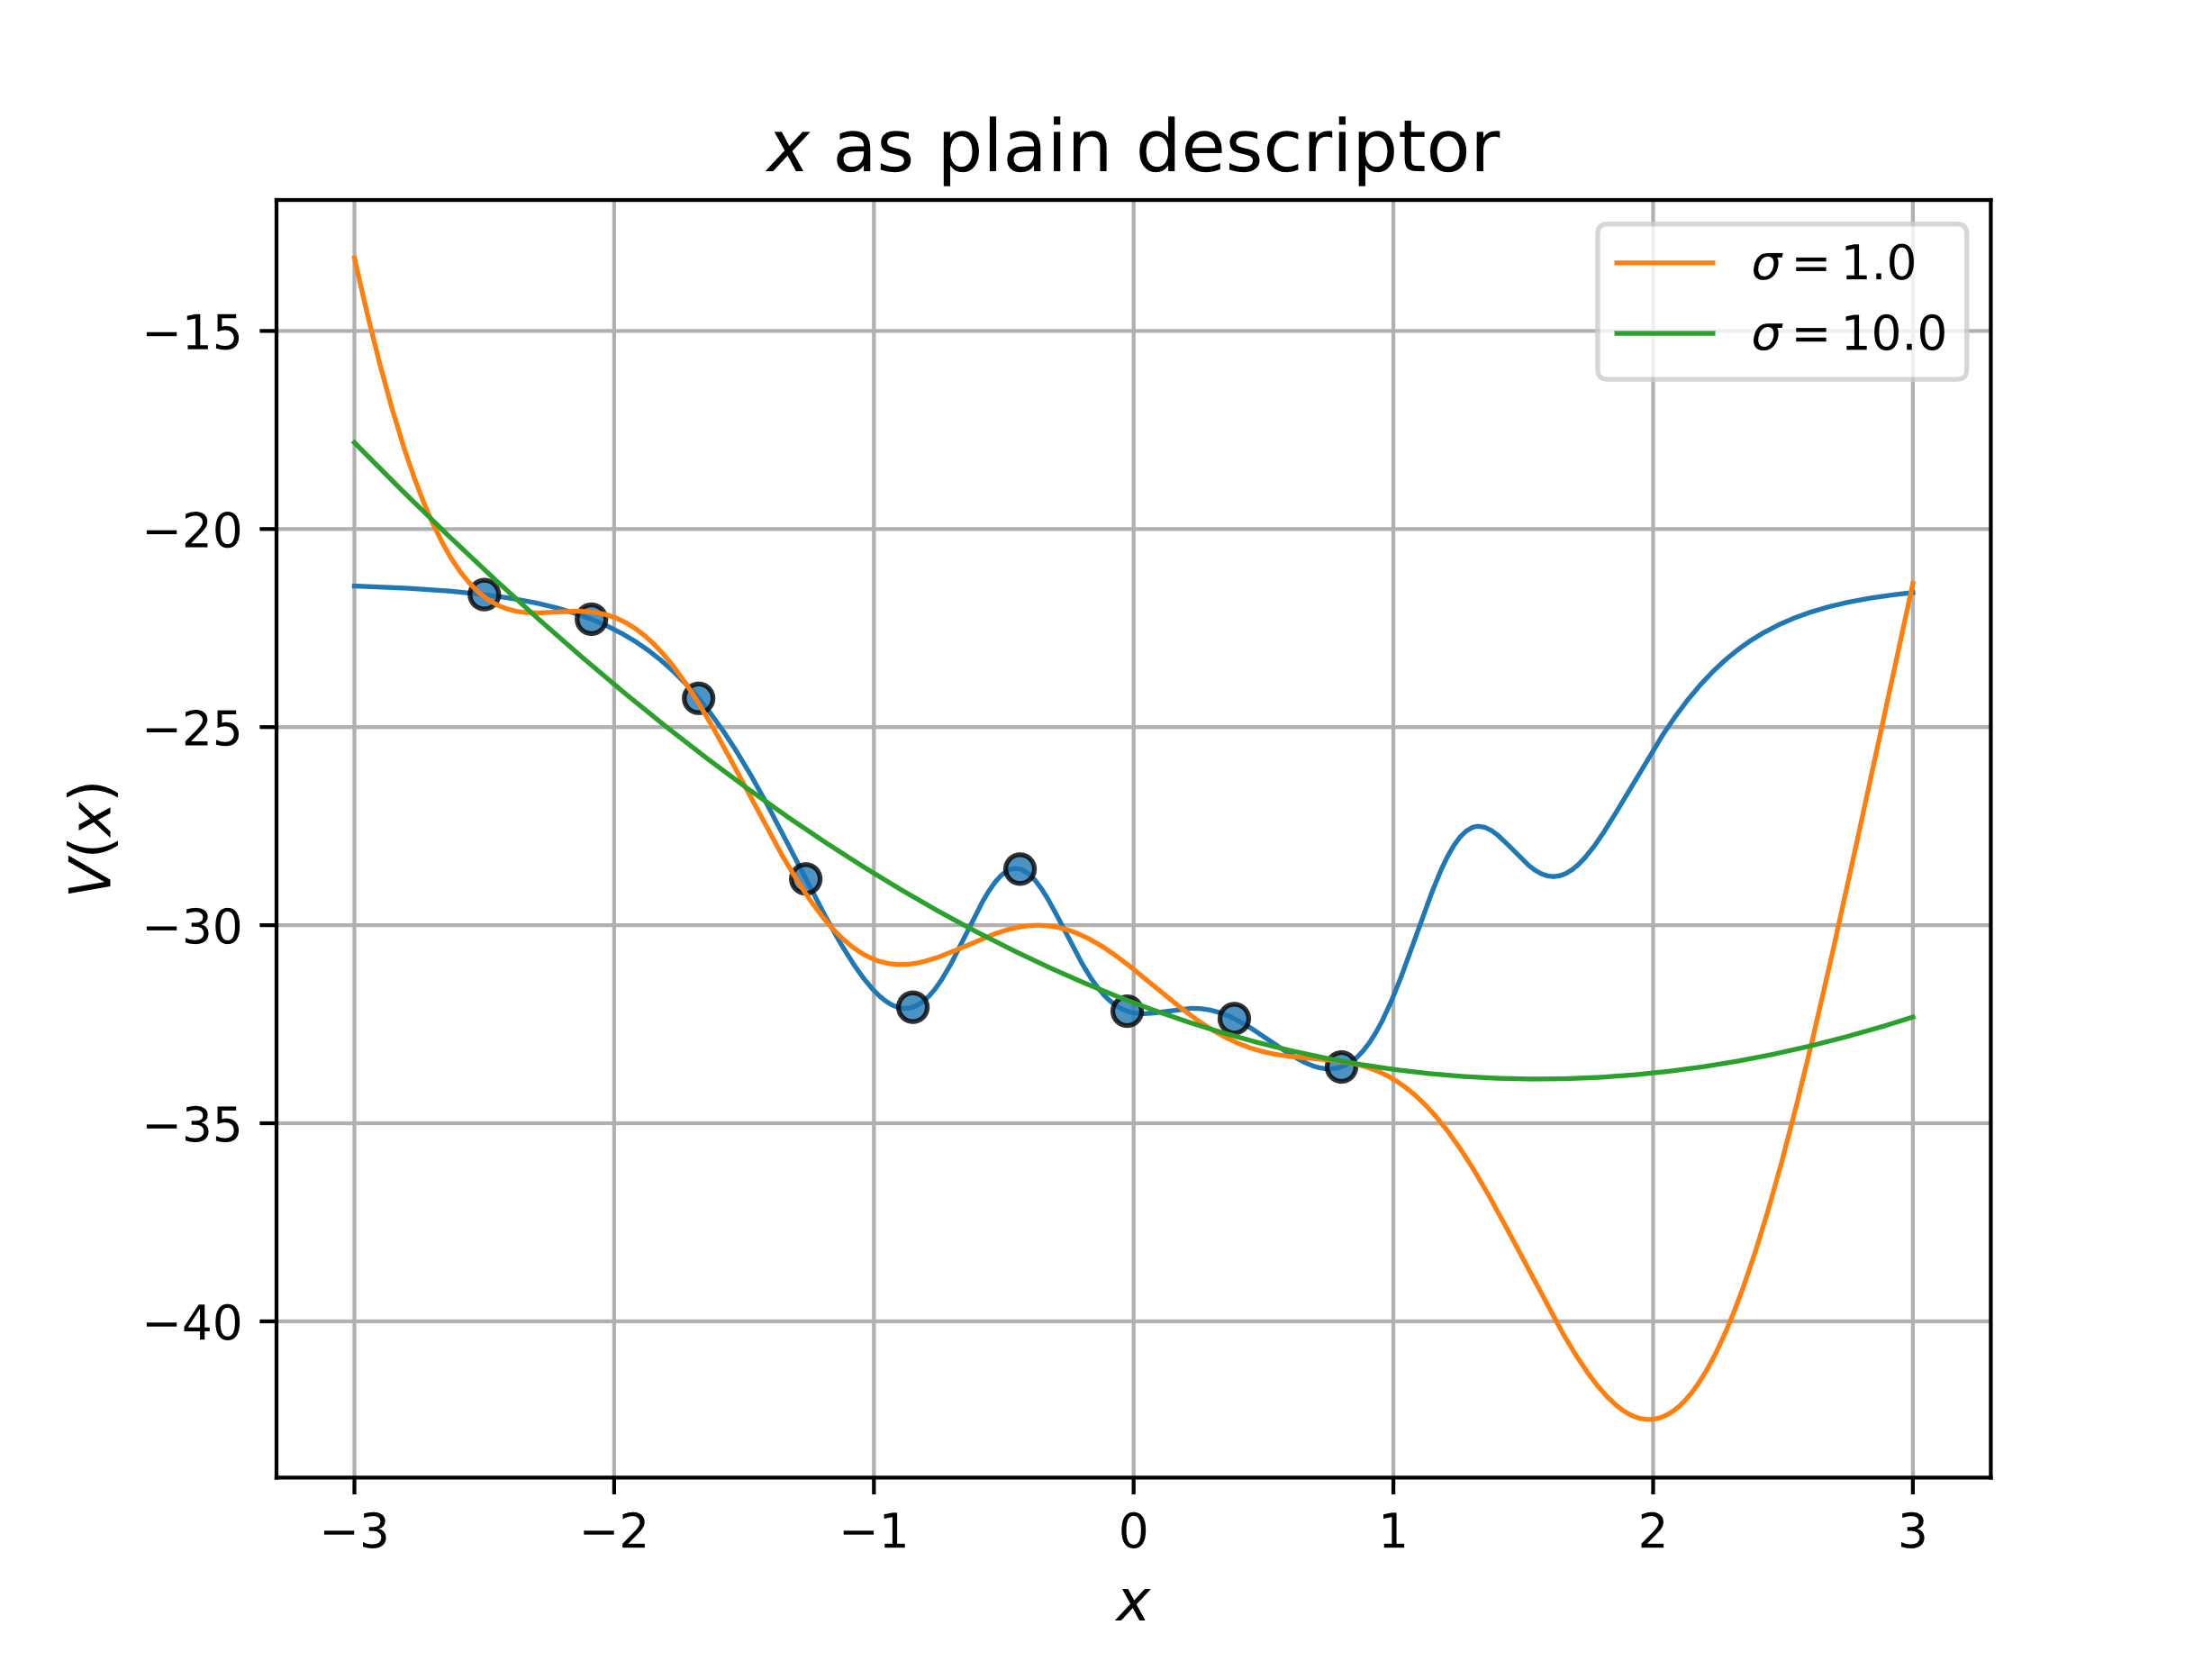
Kernel Ridge Regression – Exercise 34
Map potential with different descriptors/”fingerprints”

Slide 10
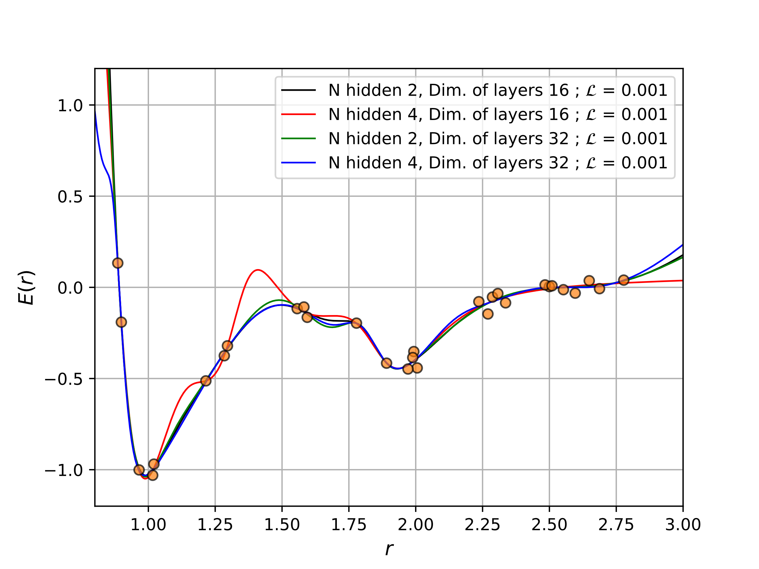
Using Neural Networks for Regression
Universal function approximator
Minimize loss as always
No more closed solutions
Hard problem
Exercise 51 → Fit LJGauss with NN
Reproducibility → No closed form
Uncertainties?

Slide 11
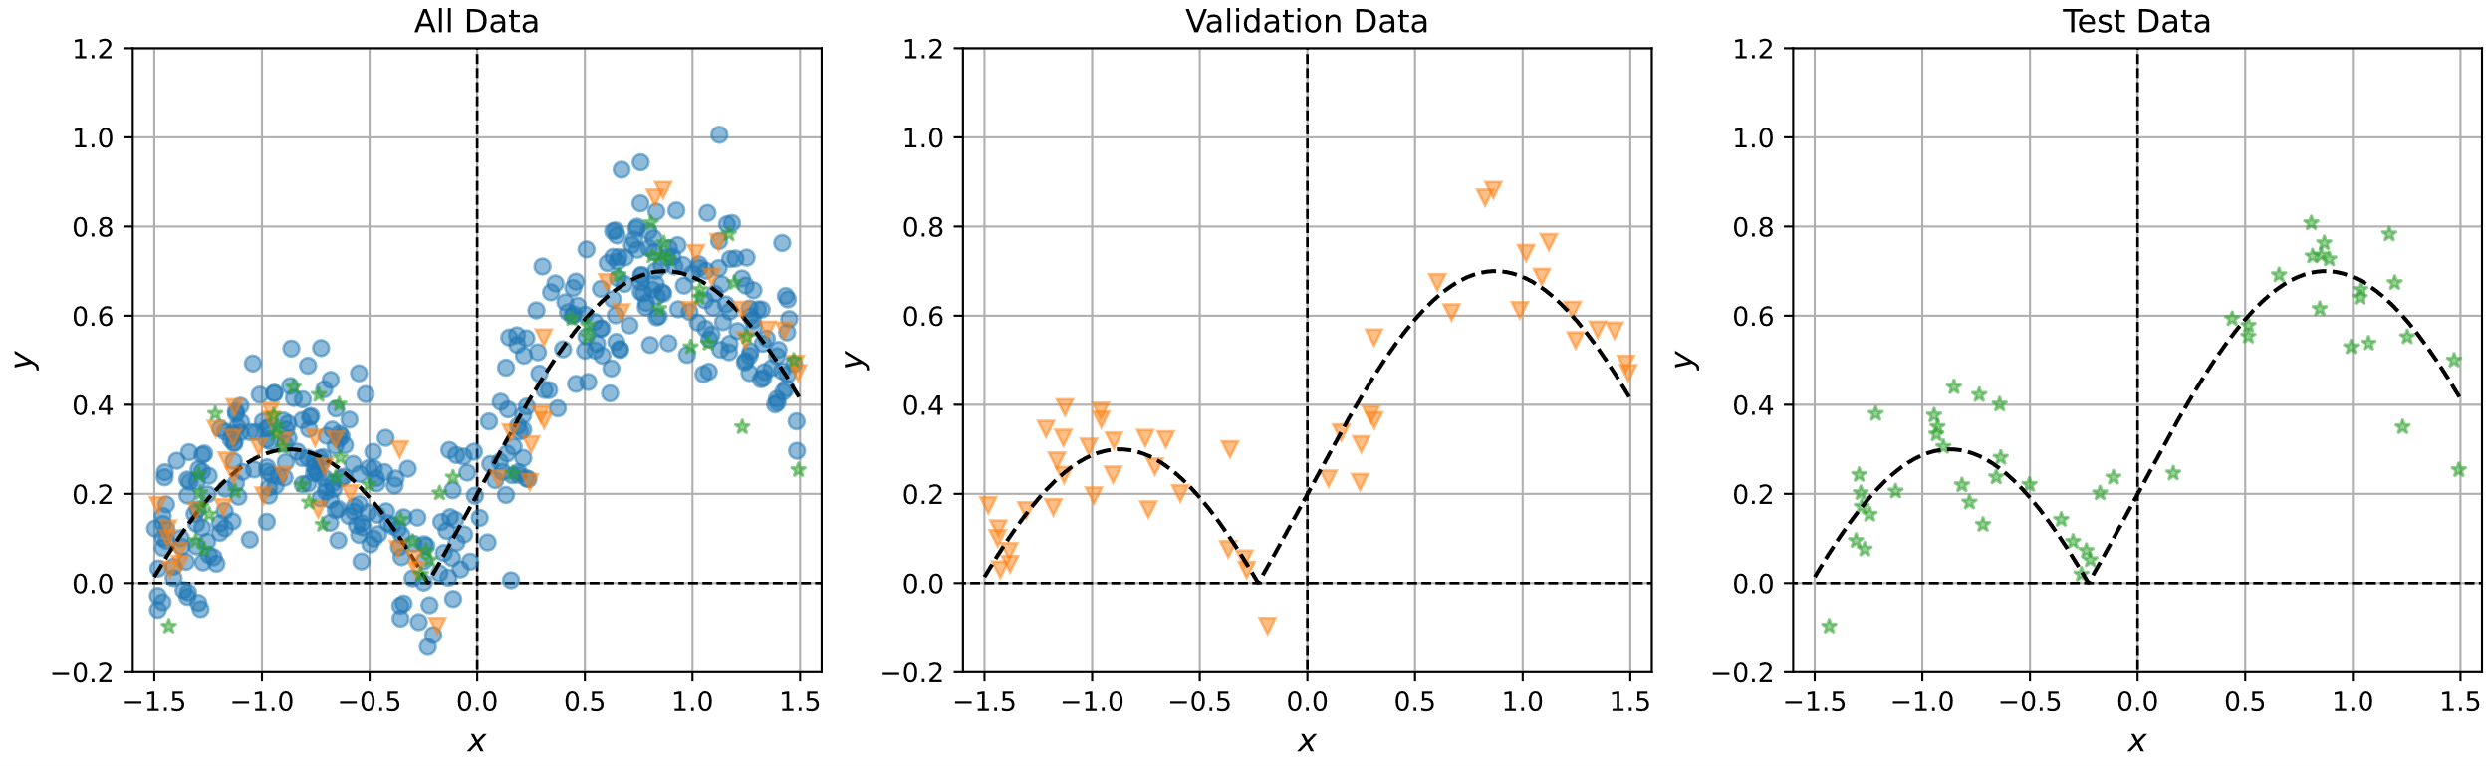
Using Neural Networks for Regression
Exercise 53 → Combat overfitting
Batch-sizing
Early stopping

Slide 12
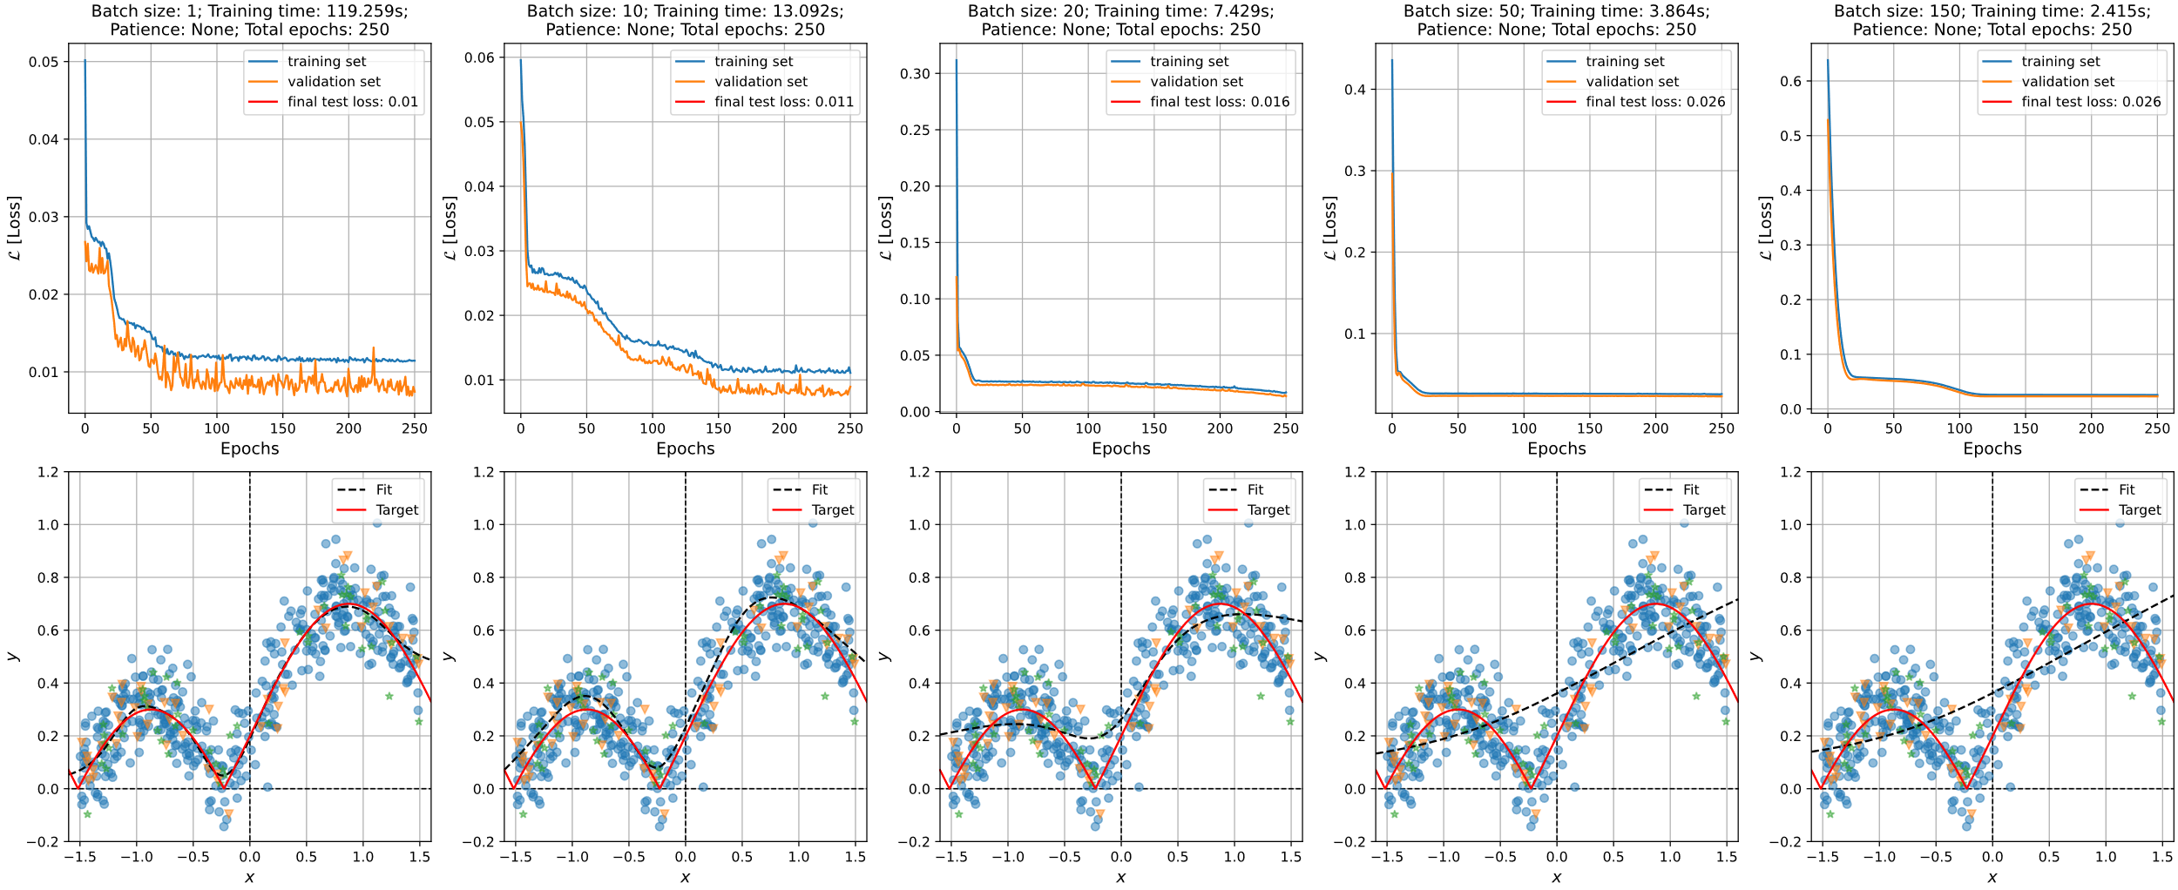
NN’s for regression – Exercise 53

Slide 13
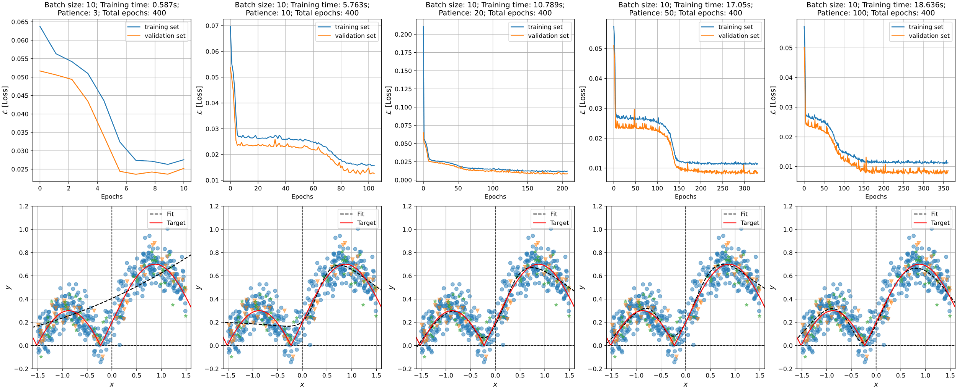
NN’s for regression – Exercise 53

